Slide 1
7 LAYERS OF OSI MODEL
PAUL WHILZEL S REAMICO
BSIT 3B

Slide 2
INTRODUCTION
The OSI Model (Open Systems Interconnection Model) is a conceptual framework used to describe the functions of a networking system. The OSI model characterizes computing functions into a universal set of rules and requirements in order to support interoperability between different products and software.
In its most basic forms, it divides network architecture into seven layers which ,from top to bottom are the Application, Presentation, Session, Transport ,Network , Data Link and Physical Layers. It is therefore often referred to as the OSI SEVEN LAYER MODEL.

Slide 3
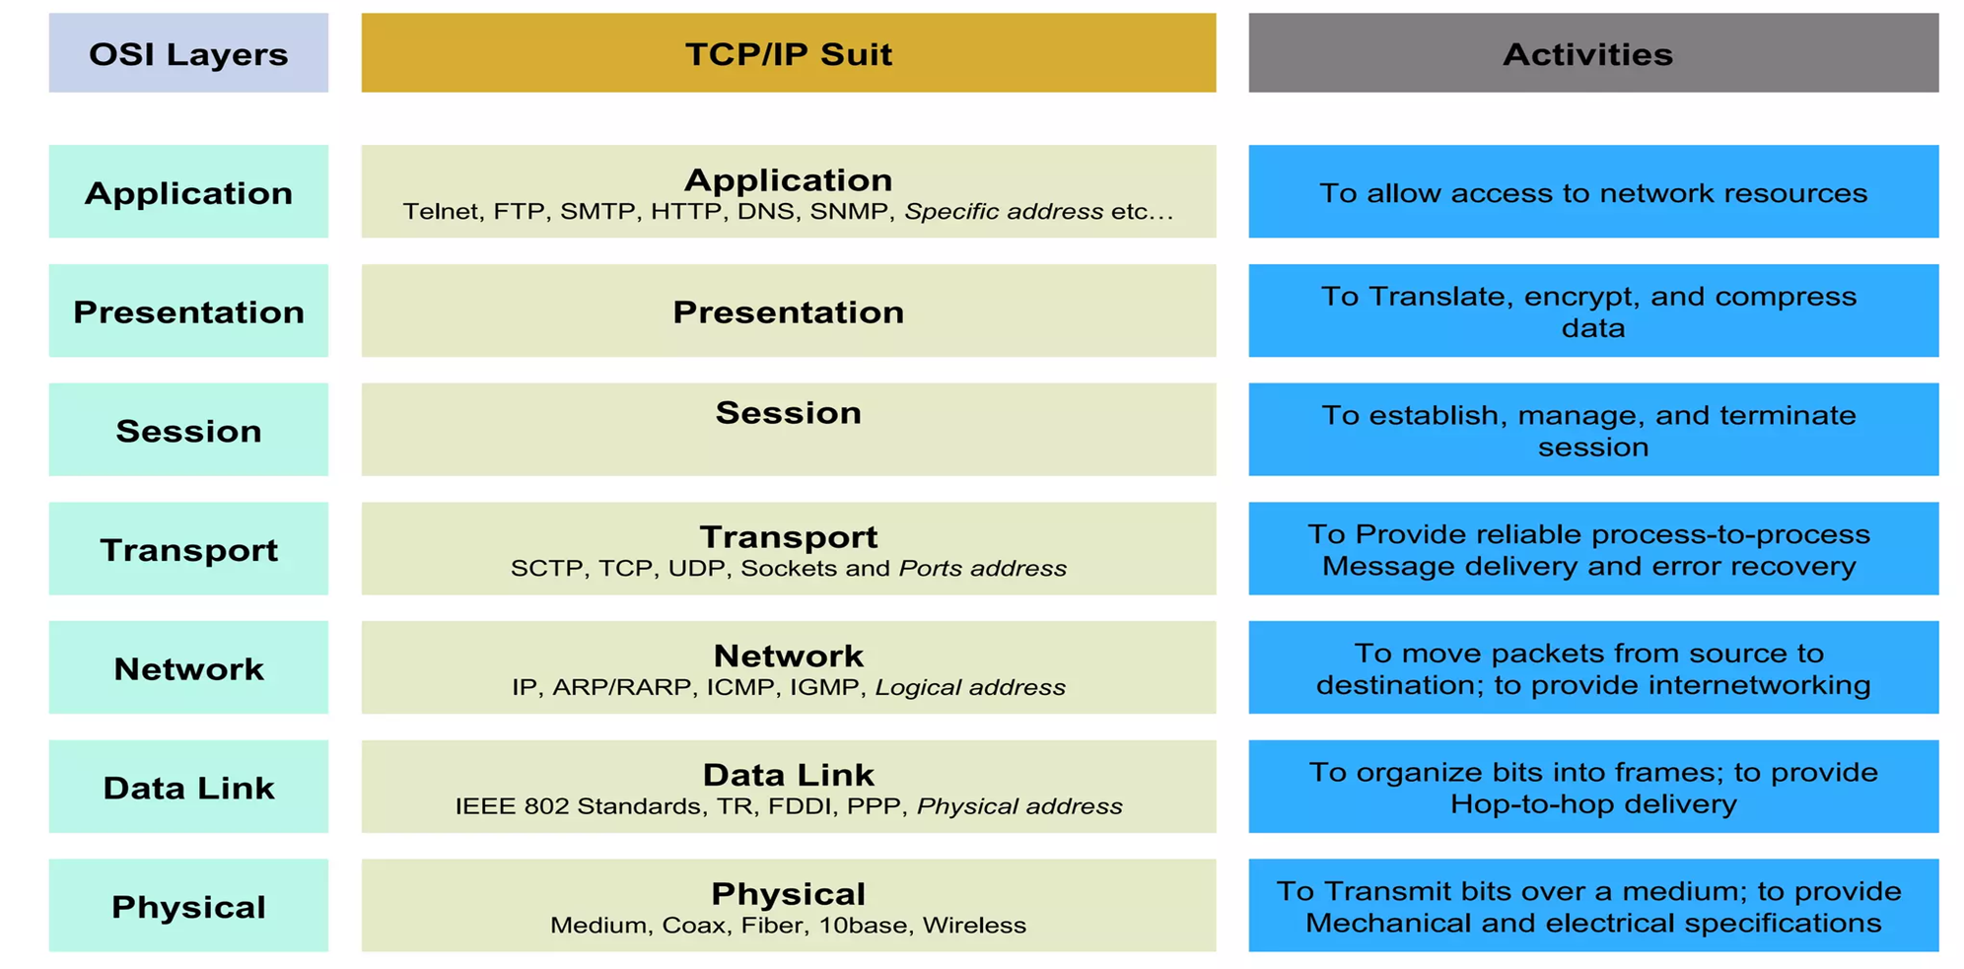

Slide 4
Layer 7: Application Layer
Level at which applications access network services.
Represents services that directly support software applications for file transfers, database access, and electronic mail etc.

Slide 5
Layer 6: Presentation Layer
Related to representation of transmitted data
Translates different data representations from the Application layer into uniform standard format
Providing services for secure efficient data transmission
e.g. data encryption, and data compression.

Slide 6
Layer 5: Session Layer
Allows two applications on different computers to establish, use, and end a session.
e.g. file transfer, remote login
Establishes dialog control
Regulates which side transmits, plus when and how long it transmits.
Performs token management and synchronization.

Slide 7
Layer 4: Transport Layer
Manages transmission packets
Repackages long messages when necessary into small packets for transmission
Reassembles packets in correct order to get the original message.
Handles error recognition and recovery.
Transport layer at receiving acknowledges packet delivery.
Resends missing packets.

Slide 8
Layer 3: Network Layer
Manages addressing/routing of data within the subnet
Addresses messages and translates logical addresses and names into physical addresses.
Determines the route from the source to the destination computer
Manages traffic problems, such as switching, routing, and controlling the congestion of data packets.
Routing can be:
Based on static tables
determined at start of each session
Individually determined for each packet, reflecting the current network load.

Slide 9
Layer 2: Data Link Layer
Packages raw bits from the Physical layer into frames (logical, structured packets for data).
Provides reliable transmission of frames
It waits for an acknowledgment from the receiving computer.
Retransmits frames for which acknowledgement not received

Slide 10
Layer 1: Physical Layer
Transmits bits from one computer to another
Regulates the transmission of a stream of bits over a physical medium.
Defines how the cable is attached to the network adapter and what transmission technique is used to send data over the cable.

Slide 11
Services in the OSI Model
In OSI model, each layer provide services to layer above, and ‘consumes’ services provided by layer below.
Active elements in a layer called entities.
Entities in same layer in different machines called peer entities.

Slide 12
Connections
Layers can offer connection-oriented or connectionless services.
Connection-oriented like telephone system.
Connectionless like postal system.
Each service has an associated Quality-of-service (e.g. reliable or unreliable).

